Slide 1
Cell organells
By
Kimaru Samuel githui

Slide 2
INTRODUCTION
About 200 different types of specialized cells carry out a multitude of functions that help each system contribute to the homeostasis of the entire body.
All cells arise from existing cells by the process of cell division, in which one cell divides into two identical cells.
Parts of Cell: 1. Plasma membrane
2. Cytoplasm
3. Nucleus

Slide 3
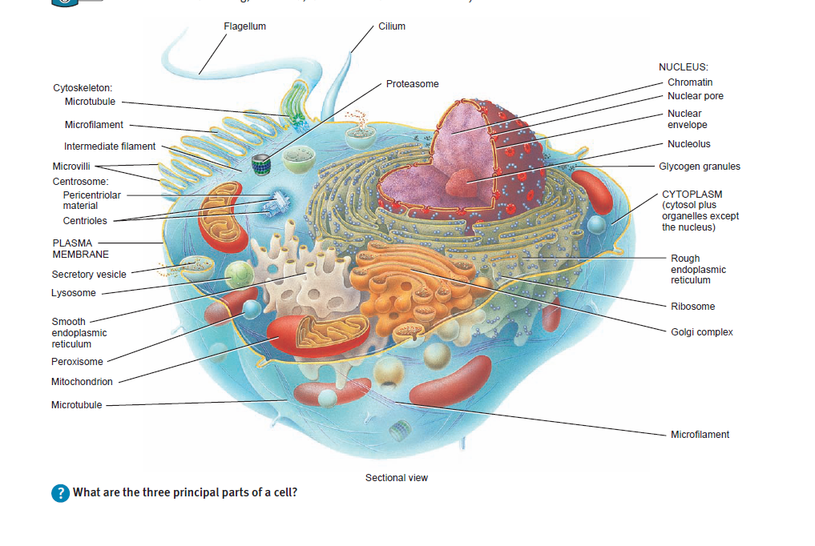

Slide 4
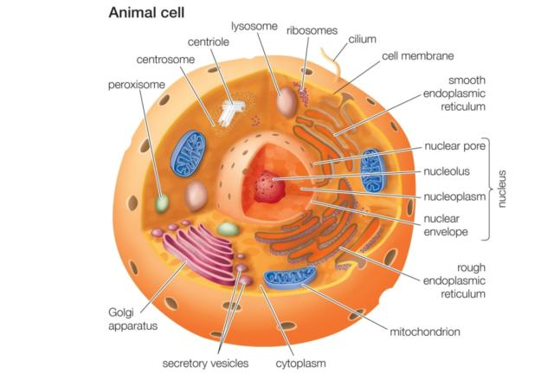

Slide 5
PLASMA MEMBRANE
The plasma membrane, a flexible yet sturdy barrier that surrounds and contains the cytoplasm of a cell.
Some proteins float freely like icebergs in the lipid sea, whereas others are anchored at specific locations like boats at a dock.
The membrane lipids allow passage of several types of lipid-soluble molecules but act as a barrier to the entry or exit of charged or polar substances.
Some of the proteins in the plasma membrane allow movement of polar molecules and ions into and out of the cell. Other proteins can act as signal receptors or adhesion molecules

Slide 6
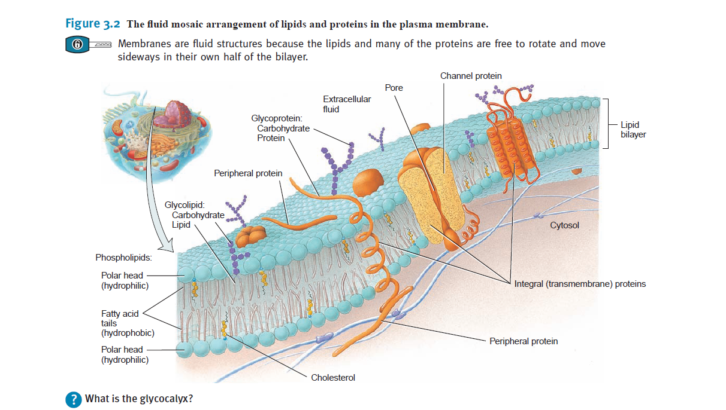
PLASMA MEMBRANE

Slide 7
(CONTINUE)
The basic structural framework of the plasma membrane is the lipid bilayer, two back-to-back layers made up of three types of lipid molecules—phospholipids, cholesterol, and glycolipids
About 75% of the membrane lipids are phospholipids, lipids that contain phosphorus
Present in smaller amounts are cholesterol (about 20%), a steroid with an attached OH (hydroxyl) group, and various glycolipids (about 5%), lipids with attached carbohydrate groups

Slide 8
(CONTINUE)
The bilayer arrangement occurs because the lipids are amphipathic molecules, which means that they have both polar and nonpolar parts
In phospholipids, the polar part is the phosphate containing
“head,” which is hydrophilic
The nonpolar parts are the two long fatty acid “tails,” which are hydrophobic (-phobic fearing) hydrocarbon chains.
The hydrophobic fatty acid tails in each half of the bilayer point toward one another, forming a non polar, hydrophobic region in the membrane’s interior.

Slide 9
ARRANGEMENT OF MEMBRANE PROTEINS
Membrane proteins are classified as integral or peripheral
according to whether they are firmly embedded in the membrane
Integral proteins extend into or through the lipid bilayer, most integral proteins are transmembrane proteins
Like membrane lipids, integral membrane proteins are amphipathic
Peripheral proteins are not as firmly embedded in the membrane
Many membrane proteins are glycoproteins
Carbohydrate portions of glycolipids and glycoproteins form an extensive sugary coat called the glycocalyx exa: WBC, RBC, protects cells that line the airways and the gastrointestinal tract from drying out

Slide 10
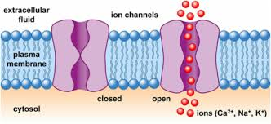
FUNCTIONS OF MEMBRANE PROTEINS
Variety of proteins contribute to different kinds of functions
Some integral membrane proteins form ion channels, pores
or holes through which specific ions, such as potassium ions
(K), can flow to get into or out of the cell.

Slide 11
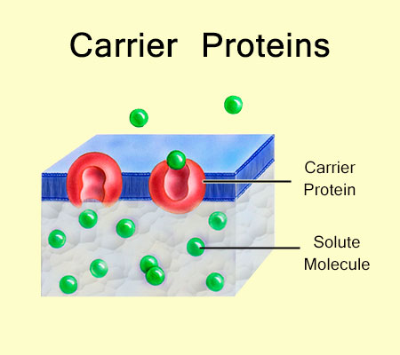
(continue)
Other integral proteins act as carriers, selectively moving a polar substance or ion from one side of the membrane to the other. Carriers are also known as transporters.

Slide 12
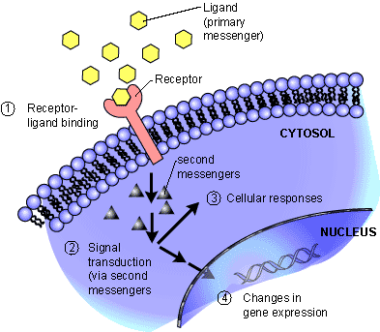
(continue)
Integral proteins called receptors serve as cellular recognition
sites. Each type of receptor recognizes and binds a specific type of molecule.

Slide 13
(continue)
Some integral proteins are enzymes that catalyze specific
chemical reactions at the inside or outside surface of the cell.
Integral proteins may also serve as linkers, which anchor proteins in the plasma membranes of neighboring cells to one another or to protein filaments inside and outside the cell.
Membrane glycoproteins and glycolipids often serve as cell identity markers. They may enable a cell to recognize other cells of the same kind during tissue formation or to recognize and respond to potentially dangerous foreign cells. The ABO blood type markers are one example of cell identity markers. When you receive a blood transfusion, the blood type must be compatible with your own.

Slide 14
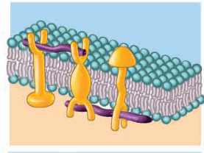
Anchoring Proteins
Cell Identity Markers

Slide 15
MEMBRANE FLUIDITY
Membranes are fluid structures
Neighboring lipid molecules exchange places about 10 million times per second and may wander completely around a cell in only a few minutes!
Membrane fluidity depends both on the number of double bonds in the fatty acid tails of the lipids that make up the bilayer, and on the amount of cholesterol present.
Membrane fluidity is an excellent compromise for the cell; a rigid membrane would lack mobility, and a completely fluid membrane would lack the structural organization and mechanical support required by the cell.

Slide 16
(Continue)
Enables the movement of the membrane components responsible for cellular processes such as cell movement, growth, division, and secretion
Fluidity allows the lipid bilayer to self-seal if torn or punctured Exa. Cloning

Slide 17
MEMBRANE PERMEABILITY
Permeable and Impermeable means..
Permeability of the plasma membrane to different substances varies.
Plasma membranes permit some substances to pass more readily than others. This property of membranes is termed selective permeability.
The lipid bilayer portion of the membrane is permeable to nonpolar, uncharged molecules, such as oxygen, carbon dioxide, and steroids, but is impermeable to ions and large, uncharged polar molecules such as glucose.
Macromolecules, such as proteins, are so large that they are unable to pass across the plasma membrane except by endocytosis and exocytosis

Slide 18
GRADIENT ACROSS THE PLASMA MEMBRANE
The selective permeability of the plasma membrane allows a living cell to maintain different concentrations of certain substances on either side of the plasma membrane.
A concentration gradient is a difference in the concentration of a chemical from one place to another.
Na & O2 accumulated within outside of cells
CO2 & K accumulated within inside of cells
A difference in electrical charges between two regions constitutes an electrical gradient.
Because it occurs across the plasma membrane, this charge difference is termed the membrane potential.

Slide 19
(continue)
Concentration gradient and electrical gradient are important because they help move substances across the plasma membrane.
Substance will move across a plasma membrane down its concentration gradient (downhill).
Positively charged substance will tend to move toward a negatively charged area, and a negatively charged substance will tend to move toward a positively charged area.
The combined influence of the concentration gradient and the electrical gradient on movement of a particular ion is areferred to as its electrochemical gradient.

Slide 20
TRANSPORT ACROSS THE PLASMA MEMBRANE
.
ACTIVE PROCESS
(Require Energy)
PASSIVE PROCESS
(Not Require Energy)
UP HILL PROCESS
(ATP as Energy source)
DOWN HILL PROCESS
(Own Kinetic Energy)

Slide 21
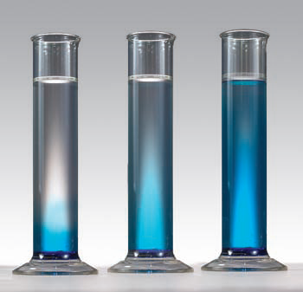
PRINCIPLE OF PASSIVE DIFFUSION

Slide 22
FACTORS AFFECTING DIFFUSION RATE ACROSS PLASMA MEMBRANE
Steepness of the concentration gradient
Temperature
Mass of the diffusing substance
Surface area
Diffusion distance

Slide 23
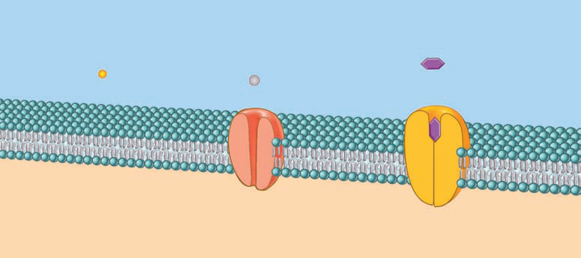
SIMPLE DIFFUSION
SIMPLE
CHANNEL
CARRIER
Non Polar, hydrophobic molecules (O2, CO2, Fat soluble vitamins, Water) move across the lipid bilayer through the process of simple diffusion.

Slide 24
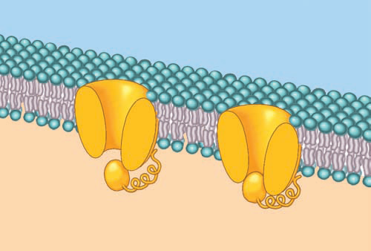
CHANNEL MEDIATED DIFFUSION
K
K
K

Slide 25
(CONTINUE)
Solutes move down its concentration gradients
Most of membrane channels are ion channels
Allow passage of small, inorganic ions that are too hydrophilic to penetrate the nonpolar interior of the lipid bilayer
Numerous ion channels are selective for K (potassium ions) or Cl (chloride ions); fewer channels are available for Na (sodium ions) or Ca2 (calcium ions)
Transport of ions by this mechanism is slower compare to passive diffusion due to smaller area occupy by ion channels
Gate regulate transport of ions across plasma membrane

Slide 26
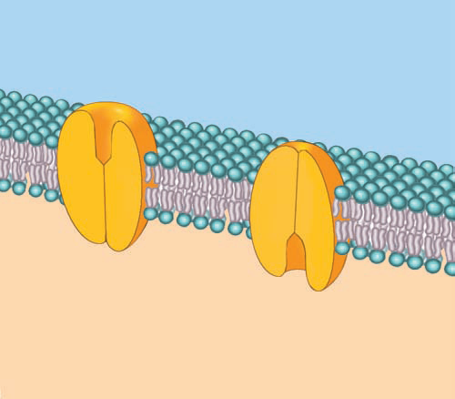
CARRIER MEDIATED FACILITATED DIFFUSION
GLUCOSE

Slide 27
(CONTINUE)
Carrier (also called a transporter) is used to move a solute down its concentration gradient across the plasma membrane
Carrier transport molecules by changing the shape
Rate of transport determined by concentration gradient across plasma membrane
Transportation process follows the principle of Transport Maximum & show saturation phemomena
Include glucose, fructose, galactose, and some vitamins.

Slide 28
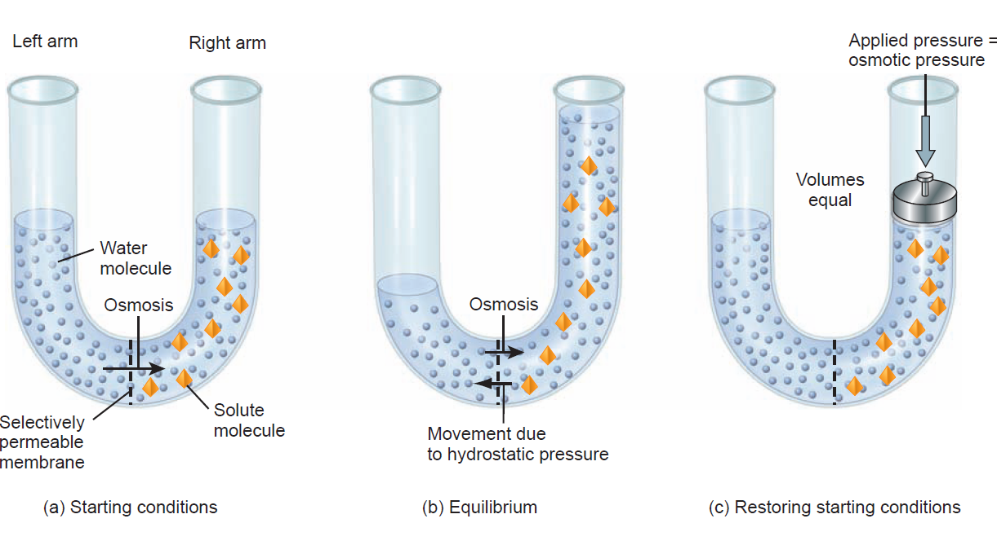
PRINCIPLE OF OSMOSIS
Notes:
Osmosis -a process by which molecules of a solvent tend to pass through a semipermeable membrane from a less concentrated solution into a more concentrated one, thus equalizing the concentrations on each side of the membrane.

Slide 29
(CONTINUE)
Type of diffusion in which there is net movement of a solvent through a selectively permeable membrane.
In living organism water is solvent that move across plasma membrane by osmosis
In osmosis, water moves through a selectively permeable membrane from an area of lower solute concentration to an area of higher solute concentration.
During osmosis, water molecules pass through a plasma membrane in two ways:
(1) By moving through the lipid bilayer via simple diffusion
(2) By moving through aquaporins integral membrane proteins that function as water channels.

Slide 30
(continue)
The solution with the impermeable solute also exerts a force, called the osmotic pressure
The osmotic pressure of a solution is proportional to the concentration of the solute particles that cannot cross the membrane
Normally, the osmotic pressure of the cytosol is the same as the osmotic pressure of the interstitial fluid outside cells.
Because the osmotic pressure on both sides of the plasma membrane (which is selectively permeable) is the same, cell volume remains relatively constant.

Slide 31
(continue)
When body cells are placed in a solution having a different osmotic pressure than cytosol, however, the shape and volume of the cells change.
As water moves by osmosis into or out of the cells, their volume increases or decreases.
A solution’s tonicity (tonic tension) is a measure of the solution’s ability to change the volume of cells by altering their water content.

Slide 32
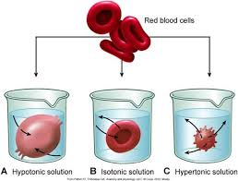

Slide 33
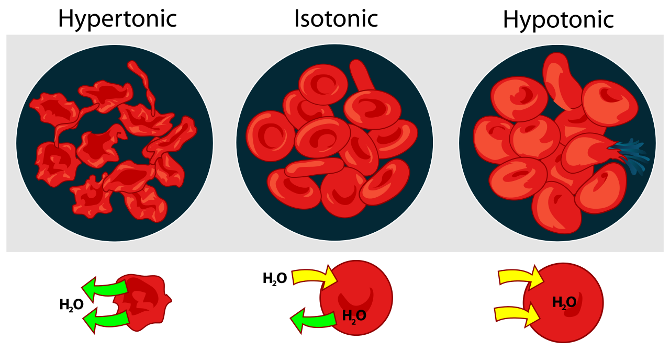

Slide 34
ACTIVE PROCESS
Polar & Charged molecules can not pass plasma membrane
Also following Up hill process
Active means Energy is required for working in opposite to concentration gradient
Two sources of cellular energy can be used (1) Hydrolysis of ATP (source in primary active transport) (2) Potential Energy stored in an ionic concentration gradient (source in secondary active transport)
Exhibit Transport maxima & Saturation
It includes many ions and monosaccharides

Slide 35
PRIMARY ACTIVE TRANSPORT
ATP is utilized for induction of structural change in carrier protein
Carrier proteins called as Pump
Cell’s 40% of energy utilized for working of pump
Chemicals that turn off ATP production, for example, the poison cyanide are lethal because they shut down active transport in cells throughout the body.
Most prevalent pump is Na/K ATPase pump
All cells have thousands of sodium-potassium pumps in their plasma membranes.
Maintain low Na ion level inside & low K ion level outside
Na/K ATPase pump working continuosly against leakage of ion channels OR secondary active transport

Slide 36
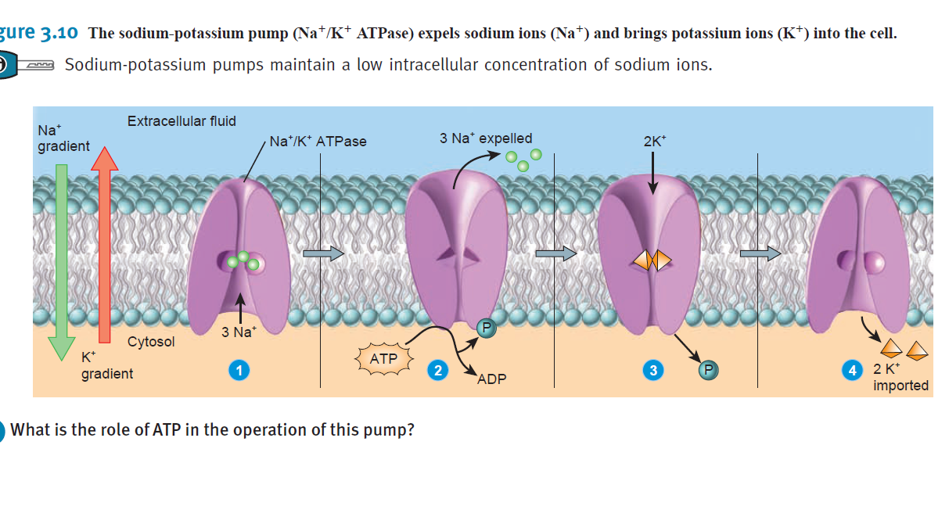

Slide 37
(continue)
Concentration gradient thus established responsible for initiation of action potential
Na responsible for tonicity of Intracellular fluid
K responsible for tonicity of extracellular fluid

Slide 38
SECONDARY ACTIVE TRANSPORT
Energy stored in a Na or H concentration gradient is used to drive other substances across the membrane against their own concentration gradients.
Indirectly uses energy obtained from the hydrolysis of ATP
Potential energy converted to kinetic energy & transport other substances against their concentration gradient
Transporters move two substances in the same direction they are called Symporters
Antiporters, in contrast, move two substances in opposite directions across the membrane.

Slide 39
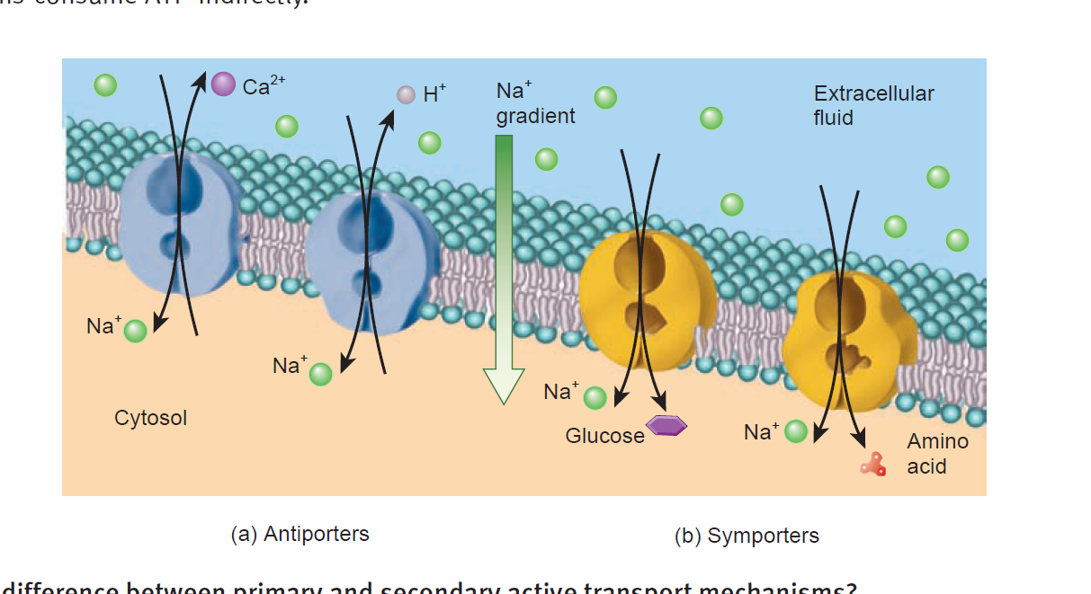

Slide 40
TRANSPORT IN VESICLES
Vesicle means small spherical sac
Import materials from and release materials into extracellular fluid
During Endocytosis materials move into a cell in a vesicle formed from the plasma membrane.
In Exocytosis materials move out of a cell by the fusion with the plasma membrane of vesicles formed inside the cell
Both endocytosis and exocytosis require energy supplied by ATP

Slide 41
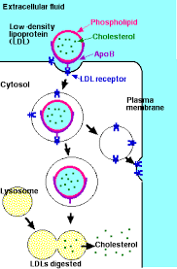
RECEPTOR MEDIATED ENDOCYTOSIS

Slide 42
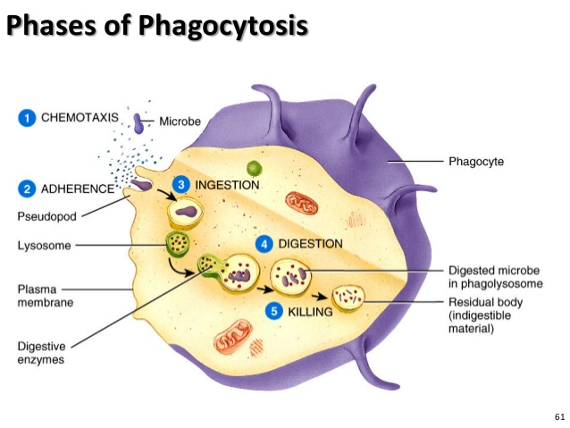

Slide 43
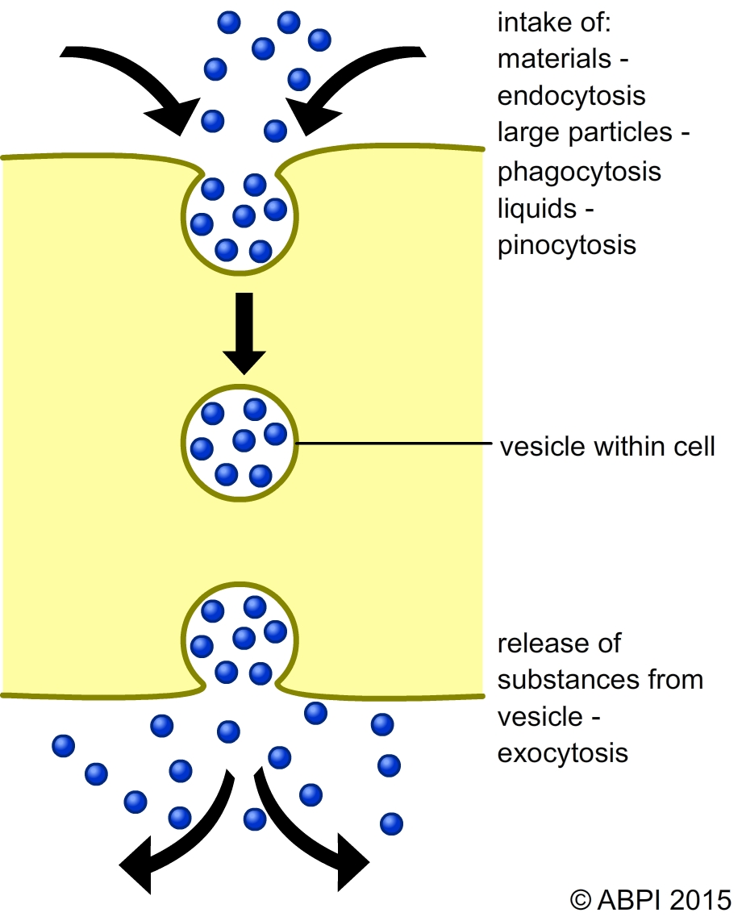
PINOCYTOSIS/BULK PHASE ENDOCYTOSIS

Slide 44
EXOCYTOSIS
Exocytosis releases materials from a cell
Important in two types of cells: (1) secretory cells that liberate digestive enzymes, hormones, mucus, or other secretions; (2) nerve cells that release substances called neurotransmitters
During exocytosis, membrane-enclosed vesicles called secretory vesicles form inside the cell, fuse with the plasma membrane, and release their contents into the extracellular fluid
Segments of the plasma membrane lost through endocytosis are recovered or recycled by exocytosis
TRANSCYTOSIS in pregnancy

Slide 45
CYTOPLASM
Consists of all the cellular contents between the plasma membrane and the nucleus
Has two components:(1) the cytosol and (2) organelles
The cytosol (intracellular fluid) is the fluid portion of the cytoplasm that surrounds organelles and constitutes about 55% of total cell volume.
Varies in composition and consistency from one part of a cell to another but 75–90% water plus various dissolved and suspended components

Slide 46
(continue)
Among these are different types of ions, glucose, amino acids, fatty acids, proteins, lipids, ATP, and waste products
The cytosol is the site of many chemical reactions required for a cell’s existence
Enzymes in cytosol catalyze glycolysis
Other types of cytosolic reactions provide the building blocks for maintenance of cell structures and for cell growth.

Slide 47
CYTOSKELETON
The cytoskeleton is a network of protein filaments that extends throughout the cytosol
Three types of filamentous proteins contribute to the cytoskeleton’s structure, as well as the structure of other organelles.
In the order of their increasing diameter, these structures are microfilaments, intermediate filaments, and microtubules.
Microfilaments are made up of actin & prevalent at edge of the cells, involved in movement of cells & mechanical support
Intermediate filaments found in parts of cells subject to mechanical stress, help stabilize the position of organelles such as the nucleus, and help attach cells to one another.

Slide 48
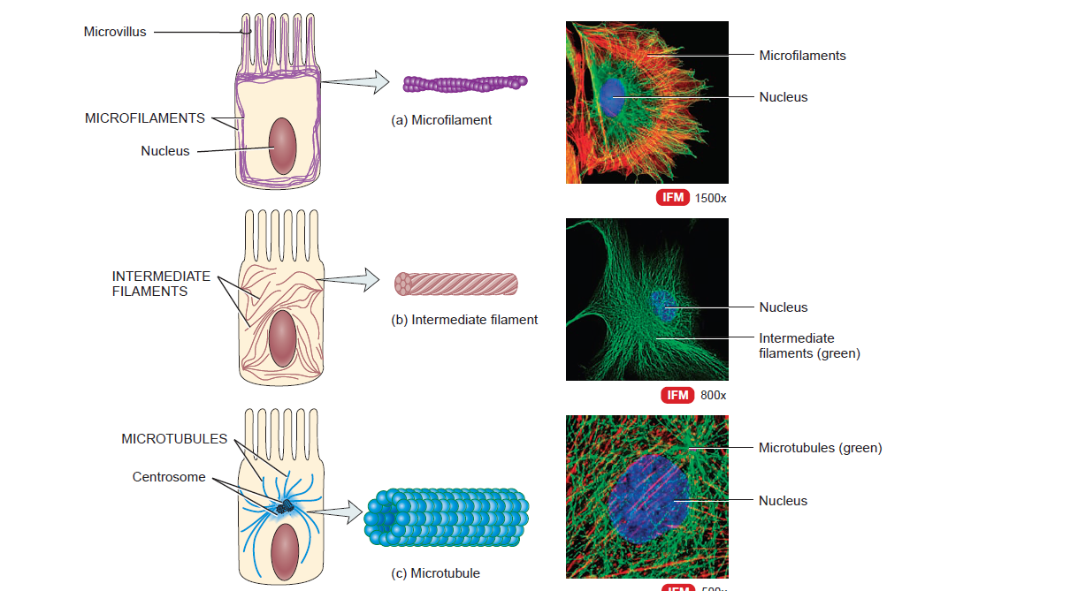

Slide 49
CENTOSOME
The centrosome, located near the nucleus, consists of two components: a pair of centrioles and pericentriolar material
The two centrioles are cylindrical structures, each composed of nine clusters of three microtubules (triplets) arranged in a circular pattern
Surrounding the centrioles is pericentriolar material which contains hundreds of ring-shaped complexes composed of the protein tubulin.
Tubulin complexes are the organizing centers for growth of the mitotic spindle, which plays a critical role in cell division, and for microtubule formation in non dividing cells

Slide 50
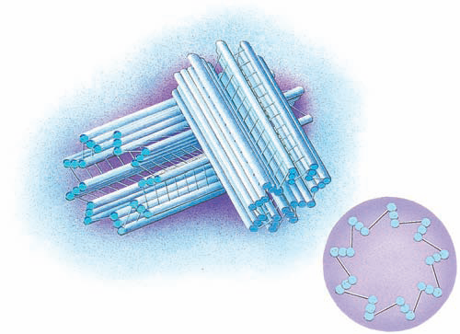

Slide 51
RIBOSOMES
Sites of protein synthesis
High content of one type of ribonucleic acid, ribosomal RNA (rRNA)
Structurally, a ribosome consists of two subunits, one about half the size of the other
The large and small subunits are made separately in the nucleolus, a spherical body inside the nucleus
Exit from nucleus separately & joined in cytoplasm
Bound ribosomes synthesize proteins destined for specific organelles, for insertion in the plasma membrane, or for export from the cell, while free involved in synthesize proteins used in the cytosol
Mitochodrial has its own ribosomes

Slide 52
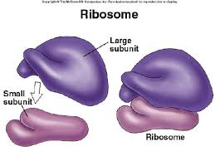

Slide 53
ENDOPLASMIC RETICULUM
Network of membranes in the form of flattened sacs or tubules
ER extends from the nuclear envelope
It constitutes more than half of the membranous surfaces within the cytoplasm of most cells
Rough ER - Proteins synthesized by ribosome attached to rough ER enter spaces within the ER for processing and sorting
Smooth ER extends from the rough ER to form a network of membrane tubules not involved in protein synthesis

Slide 54
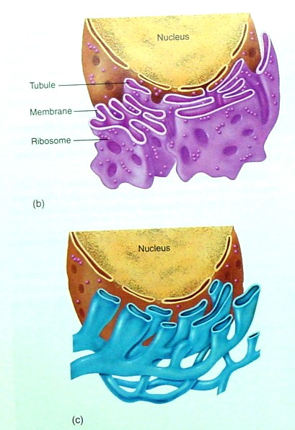
Endoplasmic Reticulum
Endoplasmic reticulum - 2 types (rough ER vs. smooth ER)
  membranous sacs or tubules with their interior regions referred to as the cisternae
  may attach to the inside of the cell membrane and possibly to the nucleus or other organelles
Rough ER (RER) - with ribosomes attached for protein synthesis, primarily secretory proteins (pinch off as vesicles); also, RER possesses enzymes in the membranous walls that produce some lipids
Smooth ER (SER) - lacks ribosomes; also possesses enzymes in its walls for lipid synthesis, but unlike RER, most of the lipids are steroids; also contains enzymes that detoxify poisons (alcohol, drugs, etc.)

Slide 55
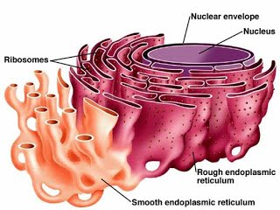

Slide 56
(continue)
Synthesize fatty acids and steroids, such as estrogens and testosterone
In liver cells, enzymes of the smooth ER help release glucose into the bloodstream and inactivate or detoxify lipid-soluble drugs or potentially harmful substances, such as alcohol, carcinogens & pesticide
In muscle cells, the calcium ions (Ca2) that trigger contraction are released from the sarcoplasmic reticulum, a form of smooth ER.

Slide 57
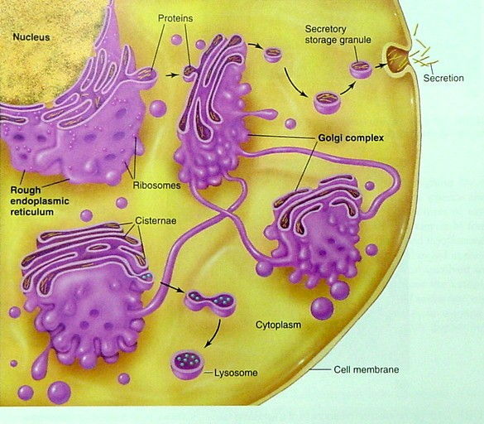
Golgi Complex
Golgi complex - series of slightly curved, flattened membranous sacs with vesicles located near its expanded ends
  Found near the nucleus and is continuous with the (R)ER.
  Packages secretory granules and plays a role in lysosome formation.
  Glycosylates proteins (adds CHOs) to form glycoproteins and concentrates proteins (by removing water) in mature secretory granules.

Slide 58
Mitochondria
Mitochondria - double-membraned organelle, found to exist in various shapes and numbers.
The outer membrane is smooth whereas the inner membrane is folded to form “shelf-like” cristae to increase the membrane’s surface area.
The semisolid substance within the mitochondria is called the matrix and is found between cristae with ribosomes (w/ 50S and 30S subunits), granules that bind to divalent cations (e.g. Ca++, Mg++), and prokaryotic-like DNA and can therefore self-duplicate to meet increased energy demands.
They are often referred to as the powerhouse of the cell because produces ATP - required for metabolic energy. Their presence supports the endosymbiotic theory (in plants, chloroplasts do too).

Slide 59
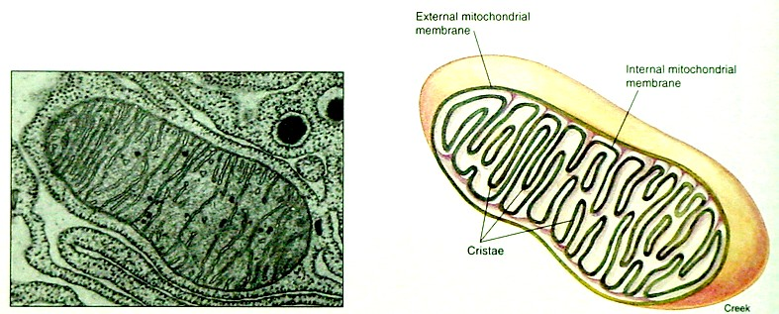

Slide 60
Lysosomes & Perixisomes
Lysosomes - membrane-bound structure that possess powerful digestive enzymes that appear granular when inactive and vesicular when activeEnzymes are capable of digesting proteins, lipids, certain carbohydrates, DNA and RNA
  When attached to phagocytic vesicles, lysosomes are known as secondary lysosomes - digest to provide cell with raw materials for synthetic reactions in the cell
  Remaining undigested materials in vacuoles - residual body
  May digest parts of the cell they reside in by attaching to a vacuole or an intracellular component - this is known as autophagocytosis
Peroxisomes - also known as microbodies and resemble lysosomes
  Possess powerful oxidative enzymes used to obtain energy from molecules and enzymes that degrade H2O2 into H2O and O2 (H2O2 is very toxic to the cell) using an enzyme called catalase or peroxidase.

Slide 61
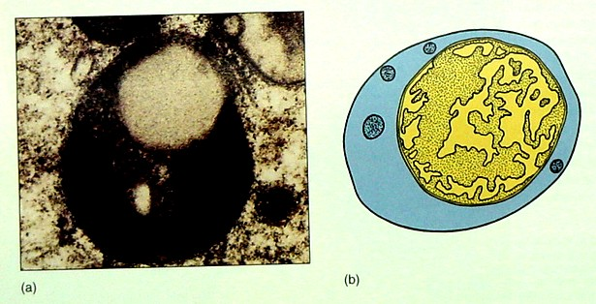

Slide 62
Fibrils and Microtubules
Fibrils and Microtubules - found coursing throughout the cytoplasm making up the "cytoskeleton".
  Fibrils, also called microfilaments (6 nm), are solid, rod-like structures that may occur in bundles. They are composed of proteins, especially actin and myosin.
  Microtubules (25 nm) are hollow, tubular rods of various lengths and are composed of protein subunits called tubulin.
Microfilaments play a major role in muscle contraction.
Microtubules direct intracellular movement, especially the movement of secretory granules, by using "MAPS" (microtubule associated proteins) - like a conveyer belt.
A variety of intermediate filaments (10 nm) also contribute to the cytoskeleton and cellular connections.

Slide 63
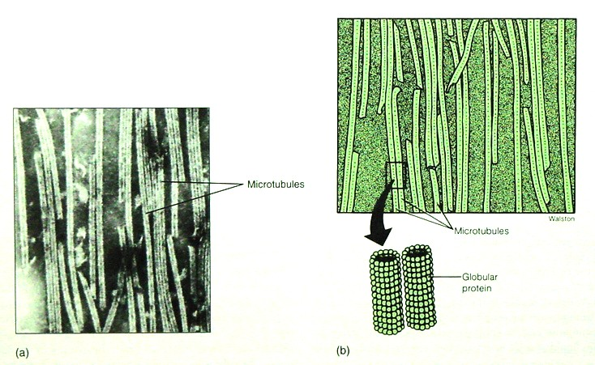

Slide 64
Cilia and Flagella
Cilia and flagella - basically, the same thing → cytoplasmic extensions of the cell with a core of microtubules.
The major difference, cilia are short and numerous, and flagella are long and few in number (usually one).
Cilia move substances along a cell surface, whereas flagella typically move a cell.
At the base of each cilium or flagellum, is a basal body composed of 9 triplets of microtubules. They act as movement coordinators for each cellular projection.

Slide 65
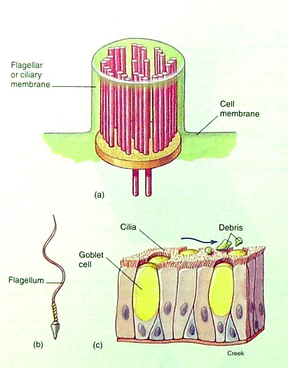
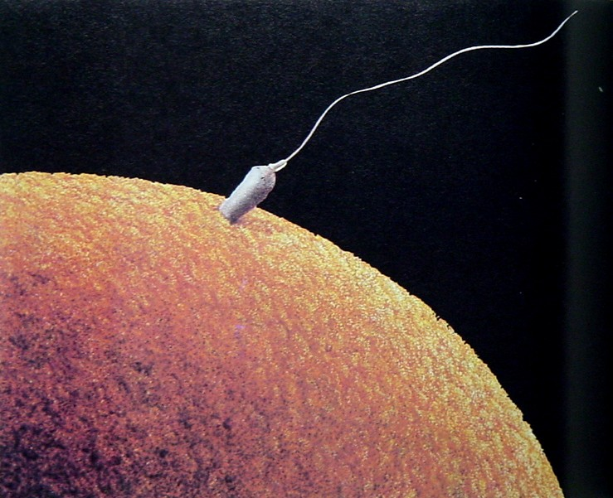
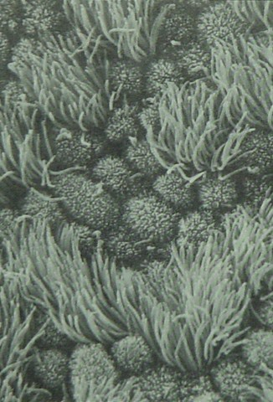

Slide 66
Nucleus, Necleolus, and Chromatin
Nucleus - large spherical structure encased by a double membrane pores (approx. 40 to 45 nm thick) called the nuclear envelope with many nuclear pores (up to 25% of envelope surface.
  The space in the membrane is called the perinuclear cisterna (or space).
Two important structures within the nucleus are the nucleolus and chromatin. They are found embedded in the nucleoplasm.
Nucleolus - small nonmenbranous mass composed of protein and RNA
  Functions to produce ribosomal subunits which leave the nucleus through nuclear pores to function in the cytoplasm.
Chromatin - coiled, thread-like genetic material composed of protein and DNA which functions to control synthetic activity of the cell via protein (enzyme) synthesis

Slide 67
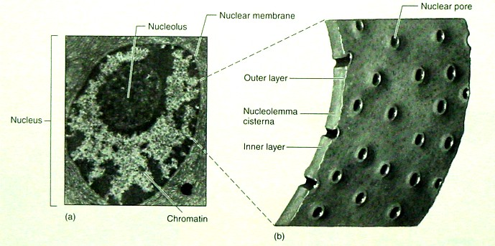

Slide 68
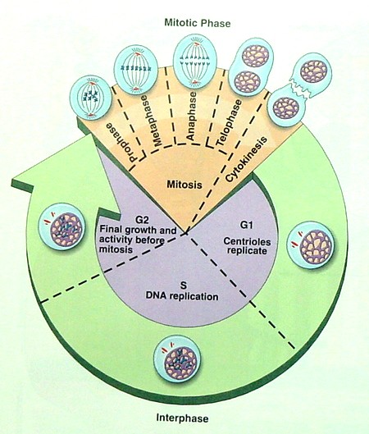
Cell Division- Mitosis and Meiosis
Mitosis - cell division where DNA replicates, then divides once - most common type of all division
Meiosis - cell division where DNA replicates, then divides twice - only occurs in the testes and ovaries

Slide 69
DNA
DNA - deoxyribonucleic acid composed of nucleotides.
  Each nucleotide has 3 parts: phosphate, sugar, and nitrogenous base.
  Only the bases differ with 4 different types: adenine, guanine, cytosine, thymine.
  Complementary base pairing: A = T and G = C.

Slide 70
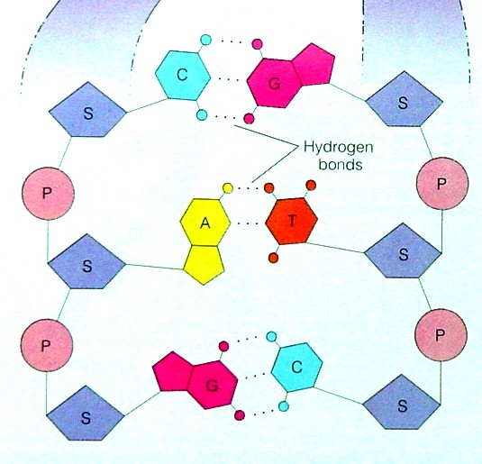
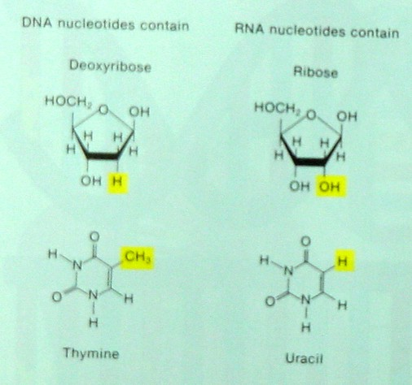

Slide 71
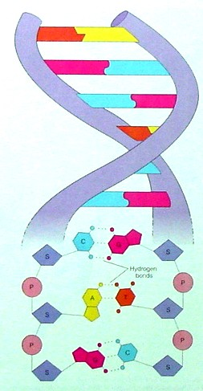

Slide 72
RNA
RNA - composed of nucleotides, like DNA, except no thymine. Instead RNA has uracil so A - U pairs up
mRNA - carries the genetic message or "codon" (3 nucleotides long) produced from a DNA "triplet“ therefore, has a complementary sequence.
  There are 64 possible codon sequences coding for only 20 different amino acids; you will only need to learn four specific codons.
tRNA - recognizes mRNA “codon” using a complementary "anticodon" and delivers a specific amino acid to a growing polypeptide chain.
rRNA - complexes with proteins to form ribosomes, upon which proteins are produced
important codons: AUG = start codon and UAA, UAG, and UGA = stop codons
  example sequence: CCG GGA AUG CCU AGU GUG CAG UUG UAA GCU = RNA for 6 amino acids (start) (stop)

Slide 73
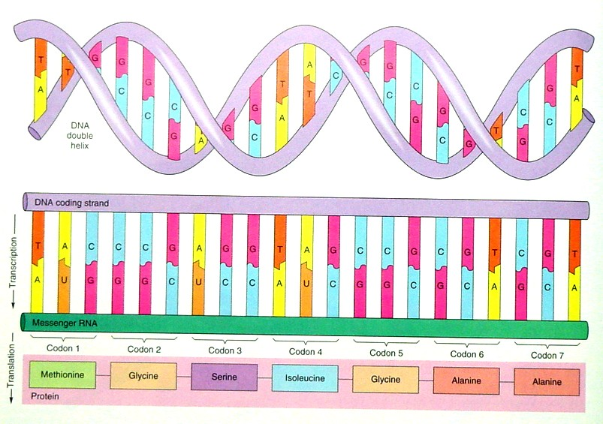

Slide 74
Replication, Transcription and Translation
Replication: DNA makes exact (or nearly exact) copy of itself
Transcription: DNA makes RNA (makes all 3 types: ribosomal RNA, transfer RNA, and messenger RNA)
Translation: protein synthesis (uses all 3 types of RNA) and occurs on ribosomes (free or membrane-bound)

Slide 75
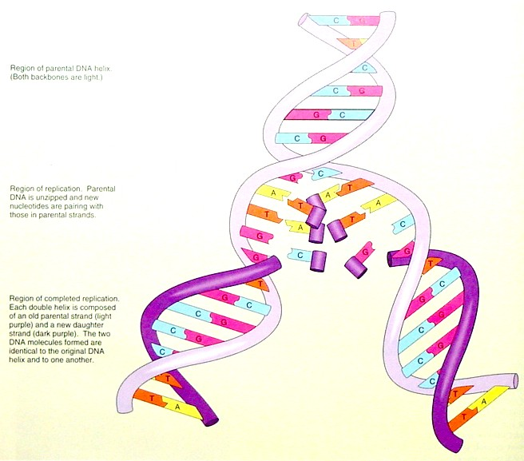

Slide 76
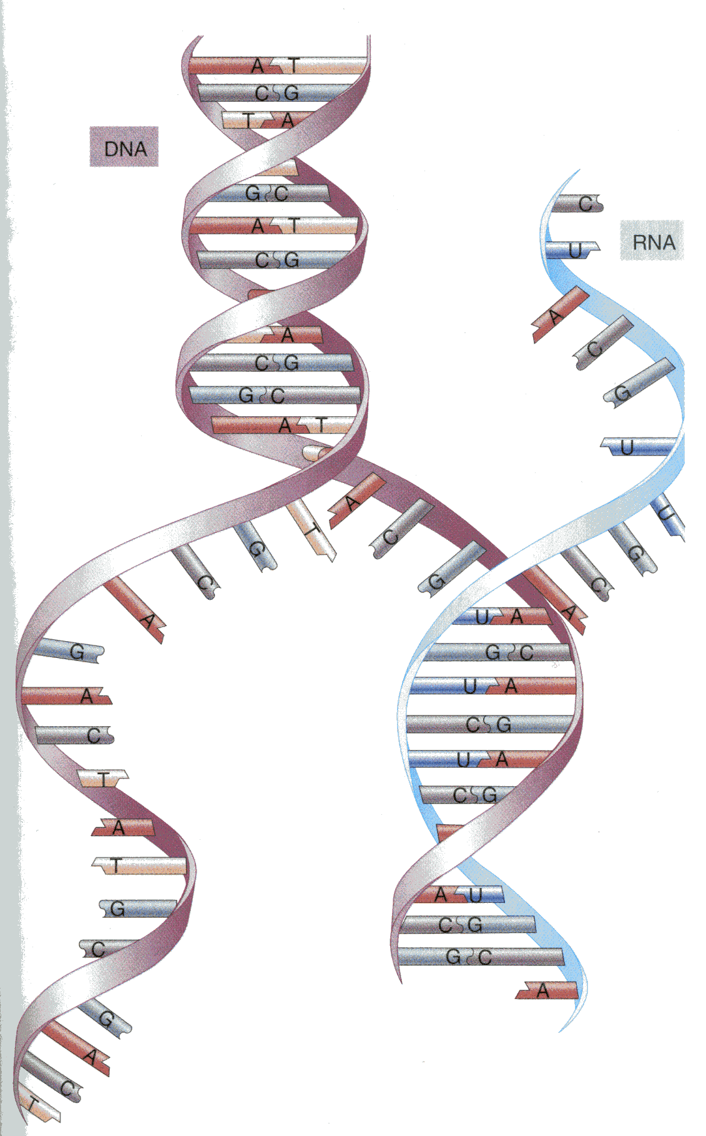

Slide 77
